Slide 1

Subject Choice
Presented By Eimear Flanagan
eflanagan@eurekaschool.ie
www.eurekaschool.ie

Slide 2
Senior Cycle – (Traditional LC)
Huge difference between Junior and Senior Cycle
Fewer subjects for examination so subjects are studied in greater depth
More time given to those subjects e.g. from 3 classes to 5 per week
The level of difficulty with regard to subjects is much higher

Slide 3
Senior Cycle changes
All subjects are offered at honours and pass level
Irish and Maths available at foundation level also
Students will be divided into honours/pass in Irish, English, Maths and French in 5th Year
Optional subjects are all taught at honours level
The way subjects are graded is more exact, so instead of a C (55%-69%) in the JC every 5% from 40% to 90% at LC will get a different grade which in turn impacts on the overall points total

Slide 4
Leaving Cert is calculated on your SIX best subjects
Percentages % | Grade | Higher Level | Ordinary Level | Bonus Points HL Maths
90-100 | A1 | 100 | 60 | 125
85-89 | A2 | 90 | 50 | 115
80-84 | B1 | 85 | 45 | 110
75-79 | B2 | 80 | 40 | 105
70-74 | B3 | 75 | 35 | 100
65-69 | C1 | 70 | 30 | 95
60-64 | C2 | 65 | 25 | 90
55-59 | C3 | 60 | 20 | 85
50-54 | D1 | 55 | 15 | 80
45-49 | D2 | 50 | 10 | 75
40-44 | D3 | 45 | 5 | 70

Slide 5
How Do I Decide?
Notes:
A There are number of things students should consider when choosing Leaving Certificate subjects. Firstly, they should think about the subjects they enjoy and why they enjoy them. If students enjoy their subjects they are more likely to study them and get better grades.
Also, if a student enjoys a subject in school it is likely that they will enjoy a college course in a similar area and eventually a job in that field.
If there are subject requirements for a course they will be in an area related to that field of study. Students should also consider what they enjoy doing outside school. Hobbies and interests might give some clues as to what subjects they enjoy.
Secondly, students should consider the subjects where they shine. It may be helpful to discuss this with friends and relatives. Consider Junior Certificate results as well as any aptitude testing done in school. Students currently in Transition Year, should consider what modules you have enjoyed so far.
Finally, consider possible entry requirements for third level. For example, science courses will require students to have taken science at Leaving Certificate, but students who are interested in careers in science are likely to enjoy science and will probably opt for at least one science subject anyw

Slide 6

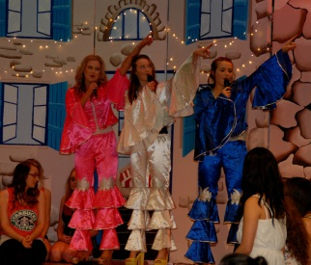

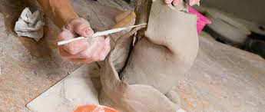

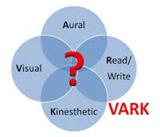
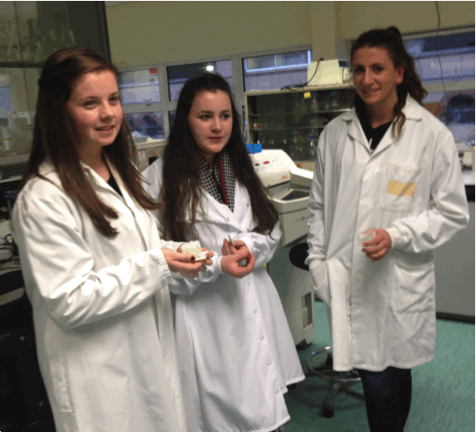

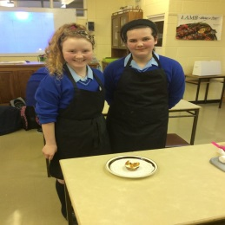


Three Core Elements when making Subject Choice for Leaving Cert
INTERESTS
ABILITIES
SKILLS
Notes:
Interests : Interest Assessment Results – Realist Investigative Artistic Social , Subjects at the moment
Abilities: VARK ;Learning Style and DATS
Skills:

Slide 7

Abilities: Examine CAT4 Results
Note: The CAT4 tests are useful for finding out what students are likely to be good at. They do not provide information on what subjects they like, what tasks they enjoy doing or what way they learn best. The information is also important to consider when choosing subjects. The subject choice recommendations made in this document are based on the CAT4 only.
The other aspects of subject choice are explored through other exercises' in class. For some skill based subjects e.g. Art ,Music. Home Economics may be essential to have taken the subject for Junior Cert. It is advisable to check this out with the subject teacher if you have not taken the subject in the Junior Cert and you want to know if you can take up the subject in 5th Year.
Where you are not strong in a particular area you might want to avoid subjects which require these strengths.
Remember these tests do not measure interpersonal skills or personal qualities such as empathy, communication skills, organisational skills etc...
If you do not score highly on any of the aptitude tests it doesn’t mean that you do not have valuable strengths it just means that the strengths you have are not measured by these particular test.
N.B. Aptitudes are not static they can be developed for example by extra curricular activities

Slide 8
Verbal Reasoning
Verbal Reasoning Test
Verbal reasoning is the capacity to perceive, understand, evaluate and apply information, ideas and arguments
expressed in word form. The Verbal Reasoning test assesses the ability to understand and draw conclusions from words
and language. Performance on the test requires the capacity to use language as a means for reasoning and problem
solving. This ability will be important for any work involving reading, writing, paperwork and the use of written material,
such as marketing, advertising, administration and legal professions.
Recommendations if this is not a strength
To minimise the impact of poor language usage
Choose subjects which have practical as well as written outputs to be assessed .
Choose subjects which have project work or field study outputs to be assessed.
This isn't a strength |  | In The Middle | Fairly High Score | High Score | Very High Score
1 | 2 | 3 4 5 6 | 7 | 8 | 9-10
Verbal Reasoning: History , English and Business

Slide 9
Mandatory Subjects For Leaving Cert
English
IRISH
Maths
40% Oral
10% Aural
50% Written

Slide 10

THIRD LEVEL ENTRY REQUIREMENTS
Chemistry Veterinary, Pharmacy, Medicine
Dietetics & Food Science
E.G.
HC3 (55%) Irish for Primary Teaching
HC3 Maths for most Engineering Courses
2 Science Subjects for General Science at Trinity
3rd Language for all NUI (NUIMaynooth, Galway,Limerick, DCU,UCD)
HC3 in Music for Muisc Eduaction
OB3 in Maths Geomatics DIT
HC3 Biology
In Trinity

Slide 11

Don’t Lock yourself out from courses
Revise
Your
Data
Research
Courses
WWW.QUALIFAX.IE
WWW.CAREERSPORTAL.IE
COLLEGE WEBSITES
Current
Grades
Talk To
Teachers

Slide 12
Subjects Offered in Cnoc Mhuire
Students required to learn off Material about molecules and organis chemistry
Small amount of calculations
Study Of Life
A Lot of Memory Work
Useful for careers in Nursing/Biotechnolgy
SCIENCE
Chemistry
Biology
Agricultural Science
Physics
Focuses on farming: Crop & Soil
Combination of Geography and Biology
Maths & Calculations
Good for career in Engineering

Slide 13
Business
Mathematical side of Business
Accounting
Business
Business
Some Degree of Learning off Content
Practical Subject For students who are interested in Marketing , Trading , Communications and Management

Slide 14
Creative
Music
50%Practical
50% Written
Art
Art History Included
Portfolio

Slide 15
Construction & Design Communications Technology
Construction Studies
40%Project
60%Written
Design Communications
Technology
40% Project
60%Written

Slide 16
Geography & History
Geography
20% Fieldwork
80% Written
History
20% Research
80%Written

Slide 17
Home Economics
Home Economics
Good for Social Science/Food Science
20%completed in research compotent before written exam

Slide 18
LCVP
Do you have an interest in the World of Work?
Have you gained any work experience to date?
Exam completed in May before Leaving Cert
Award Type for LCVP
  DISTICTION 70 POINTS
  MERIT 50 POINTS
  PASS 30 POINTS
60%Portfolio
40%Written

Slide 19
LCVP Programme Requirements
LCVP students must take a minimum of five Leaving Certificate Subjects including IRISH
TWO of the above must be selected from one of the designated Vocational Subject Groupings
Students are required to follow a recognised course in a Modern European Language (other than IRISH or ENGLISH)

Slide 20
Vocational Subject Groupings (VSG’s)
Specialist Groupings: 2 subjects selected from 1 VSG Group
Construction Studies and Design Communication and Graphics
Music and Business or Accounting (any 2)
Agricultural Science and Construction Studies
Agricultural Science or Physics or Chemistry or Biology (any 2)
Home Economics and Agricultural Science or Biology
Home Economics and Art
Accounting and Business
Physics and Chemistry
Home Economics and Business or Accounting
Construction Studies and Business or Accounting

Slide 21
Considerations
Subjects That you are Good At
Subjects You
Most Enjoy
Subjects You Need at Third Level
Aptitude and Interest Tests
Guidance Counsellor

Slide 22
Common Errors
Choosing Subjects because your friends are doing them
Choosing Subjects because you like the teacher
Choosing Subjects Because of LCVP GROUPINGS
Choosing Subjects based on older siblings experience

Slide 23
Resources
www.Qualifax.ie
www.careersportal.ie
www.careerdirections.ie
DATS Results
Interest Inventories
VARK Inventory

Slide 24

Thank You
Ms.Flanagan
www.cnocmhuiregranard.ie
/support

